Slide 1

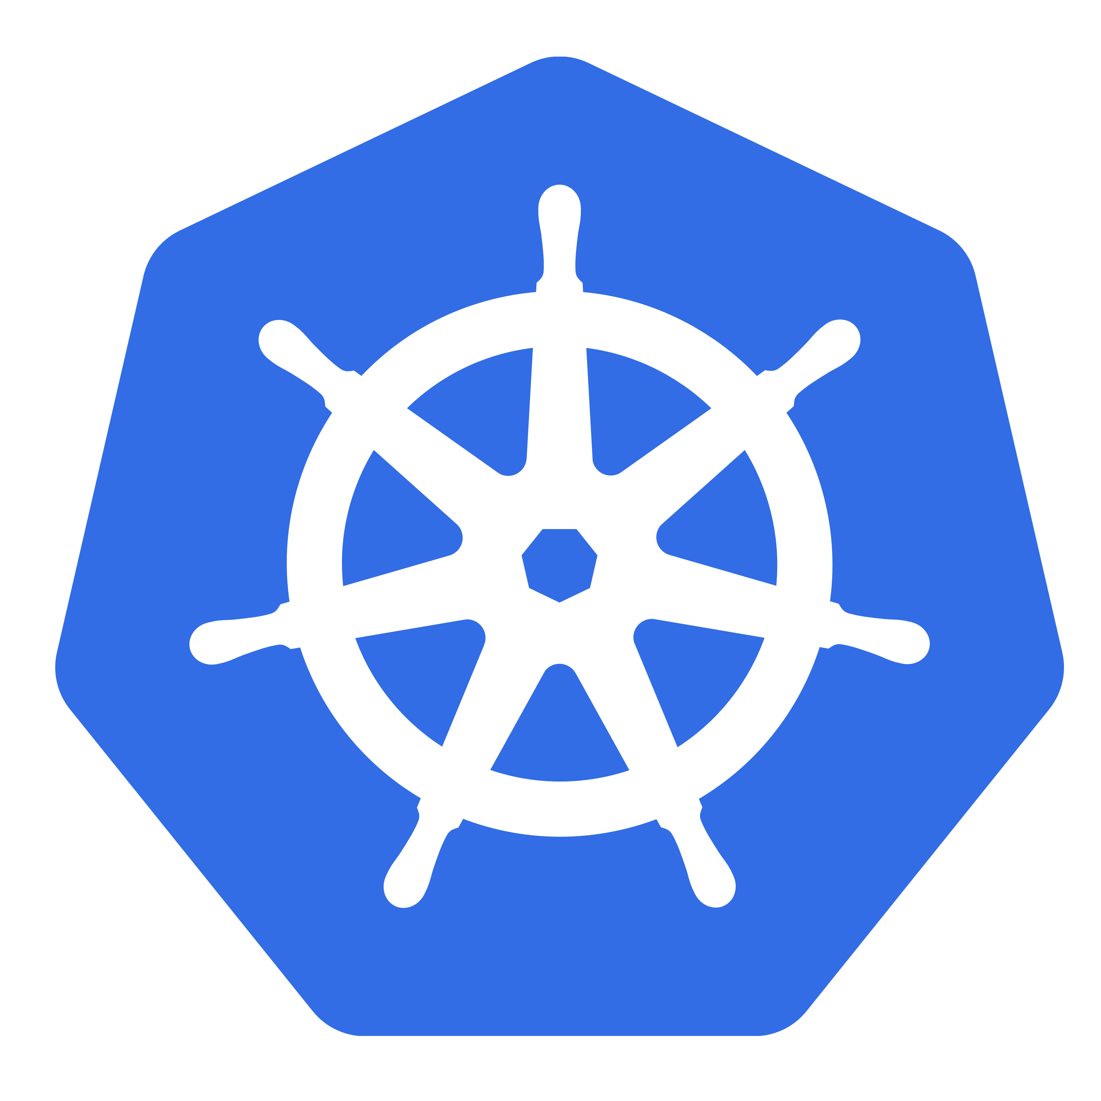
Managing Kubernetes
from Python using Kube
Dave Charles
Notes:
9/18/16
1
1

Slide 2
What this workshop is not
In depth look at kubernetes (or minikube)
A springboard to your 1000 cluster enterprise rollout using python and kube
A chance to interact with latest and greatest K8s features like deployments, petsets, daemonsets etc.
Notes:
9/18/16
2
2

Slide 3
What this workshop is
“Get your hands dirty” primer
A chance to assess if kube is for you (there are other python k8s API wrappers)
Understand some gotchas and what kube doesn’t do yet (or makes awkward)
A nice way to round off the conference in my lovely company :D
Notes:
9/18/16
3
3

Slide 4
Other Python K8s API Implementations
Kubernetes-py
https://pypi.python.org/pypi/kubernetes-py
Py-kube
https://github.com/kelproject/pykube
Python-k8sclient
https://pypi.python.org/pypi/python-k8sclient
Notes:
9/18/16
4
4
Encourage you to look at these too
So you can see for yourself this ones the best
We wrote ours because:
Abstract away from somewhat moving target
Clean watch interface
Pythonic
No swagger

Slide 5
Why Kubernetes?
Community
Accessible
Heritage
Cloud agnostic
Container runtimes
Health checks
Notes:
9/18/16
5
5
Community: Very active, supportive and productive.
Accessible: easy to play with minikube (my mac)
Heritage: Roots in Borg and Omega, concepts permeated into Kubernetes, incorporates many of the best practices that Google learned the hard way over the last decade.
Cloud agnostic: if you're using something like ECS - you're strapped to Amazon. K8s is provided my multiple vendors (AWS, Google Cloud, Azure, Rackspace etc). You can also host it yourself.
Container runtimes: Swarm means you stuck with the docker runtime when others are emerging that might have benefits for your use case (Rkt)
Health checks - flexible and easy to set up. Not just HTTP, but TCP and Exec

Slide 6

Personal Experience
Notes:
Work on a SaaS monitoring product – all on Kubernetes: recently had to roll out new SSL cert and update how our proxies worked. I was able to canary test the new proxy using updated Secrets resource containing the new cert to make sure it all worked ok. Could then bounce proxy pods in the knowledge it’d all work.

Slide 7
Use Cases
Manage K8s infrastructure
Build a dashboard
Implement kubectl in Python
Something else...
Notes:
9/18/16
7
7
So what could we use Kube for?
Manage Manage K8s infra
Testing: Set up and tear down staged deployments
Programmatically Deploy releases
Build Kubernetes Dash
Django/Flask/Pyramid + Kube could build a web app that lets you browse resources, update labels etc, scale up down replicas.
Look at Minikube dashboard
Write a python impl of kubectl (actually that’s a terrible idea)
Imagine if you gathered this info, indexed for search and stored it as a graph of relationships...
Search K8s on Cobe.IO

Slide 8
To the Terminal!
Notes:
9/18/16
8
8

Slide 9
https://github.com/davecharles/kube_workshop
Notes:
9/19/16
9
9

Slide 10
Exercise 1
Create a ReplicationController
Resource
Notes:
9/18/16
10
10
Review rc.yaml
Review create_rc.py
Create but fails - specifies pyconuk NS.
If the ``spec`` includes a namespace, create 'namespace' arg must match or an exception will be raised.
More importantly,’pyconuk’ ns does not exist!
Create pyconuk NS - review ns.yaml, note we don't specify a NS for an NS!!
Create RC, do a fetch and examine, go to dashboard?

Slide 11
Exercise 2
Creating a Service
Resource
Notes:
9/18/16
11
11
Need to create a service - target pods so we can access our app externally.
Review svc.yaml
Review create_svc.py
Minikube ip to get the IP address
Create
Navigate to kube-echo, look at name and compare to dashboard

Slide 12
Exercise 3
Using the cluster proxy
Notes:
9/19/16
12
12

Slide 13
cluster.proxy.get(
'namespaces', <namespace>,
<resourcelist>, <resourceitem>)
Notes:
9/19/16
13
13
When using proxy.get 'api/v1' is implied in get call - maybe improve this.
get('namespaces', <namespace>, <resourcelist>, <resourceitem>)
>>> cluster.proxy.get('namespaces', 'pyconuk', 'replicationcontrollers', 'kube-echo')

Slide 14
cluster.proxy.get(
'..', '..', ’apis', ’extensions',
'v1beta1', 'namespaces',
'default', 'replicasets')
Notes:
9/19/16
14
14
Get stuff from extensions API - we need to do this relatively
>>> cluster.proxy.get('..', '..', 'apis', 'extensions', 'v1beta1', 'namespaces', 'default', 'replicasets')
Review cluster_proxy.py and run
Review cluster_proxy_ext.py and run
Review cluster_proxy_ext_deployment.py and run

Slide 15
Exercise 4
Scaling an RC
Notes:
9/18/16
15
15
Scaling
Uses PATCH
scalespec = {'kind': 'Scale', 'apiVersion': 'autoscaling/v1', 'spec': {'replicas': 1}, 'metadata': {'name': 'kube-echo', 'namespace': 'pyconuk'}}
newrc = cluster.proxy.patch('namespaces', 'pyconuk', 'replicationcontrollers', 'kube-echo', 'scale', patch=scalespec)
Review scale_rc.py
Run

Slide 16
Exercise 5
Using Watch
Notes:
9/19/16
16
16
It would be nice if we could respond to updates to a resource.
We can – with watch
Review scale_rc_watch.py
Run scale_rc_watch.py
Run scale_down_rc_watch.py

Slide 17
Exercise 6
Deleting Resources
Notes:
9/18/16
17
17
Easiest way is to get the resource and call its delete method
Or you can use the cluster proxy
Review cleanup.py
Run cleanup.py

Slide 18

To Do
https://bitbucket.org/cobeio/kube
Notes:
9/18/16
18
18
H11 parser used by watch
Scale, ReplicaSets, Endpoints, PVs, PV Claims
Maybe sensibly support extensions api (Jobs, Deployments)
Ability to modify resources in general more easily

